Slide 1
Hoover-Schrum
Memorial SD #157
Annual Open Enrollment
Plan Year: July 1, 2022 - June 30, 2023
Get to know
your benefits.
Notes:
Welcome to the City of Harvey’s Annual Open Enrollment!
Before we get started, I’d like to introduce the team:
My name Bridgette Stewart, I’m the account executive with VistaNational
Rob Schaefer, Benefits Consultant with VistaNational
Ryan Hyde from Envision Healthcare is also on the call. Ryan will review the Health Reimbursement Arrangement the City implemented to help employees pay a portion of the calendar year deductible.

Slide 2
VistaNational Team
Louisa Sassi
Senior Account Manager
As the first point of contact, Louisa will assist employees with questions on plan benefits, how to obtain an ID card through carrier portals as well as with any other general questions they may have.
Direct Phone # - (630) 468-6526
sassil@vistanational.com
KATIE MULCAHY
Claims Specialist
Katie will assist employees (or dependents over age 18) in analyzing & resolution of claim issues. As their advocate, she will work directly with carriers & providers, delivering the outcome to them directly.
Direct Phone # (630) 468-6509
Direct Fax # (630) 468-6559
mulcahyk@vistanational.com
BRIDGETTE “BREE” STEWART
Senior Account Executive
Bree would be involved with any high-level account functions including renewals, open enrollment meetings, and any escalated issues.
Direct Phone # (630) 468-6528
stewartb@vistanational.com

Slide 4
2022 Open Enrollment Reminders
Open Enrollment is designed to allow employees to make changes to the plan you are currently enrolled in as well as the option to enroll in a plan which you may not currently participate in without a qualifying change in status as noted below:
Marriage
Loss of other coverage
Divorce
Birth or adoption of a child
Change in a child’s dependent status
Legal Separation
Change in employment status (ex. part-time to full-time)
Death of a dependent
If you experience a qualifying life event, please contact HR; proof of the qualifying life event must be submitted within 30 days in order to change your current benefits elections.

Slide 5
2022 Open Enrollment Plan Updates
Medical
Hoover-Schrum will renew the medical programs with BlueCross BlueSheild of IL
Envision Healthcare
Adding Health Reimbursement Account (HRA)
Dental
Changing from MetLife to Humana
Adding Child Orthodontia Benefit
Group Life/AD&D
Changing from Reliance Standard to BlueCross BlueShield of IL
Supplemental Life/AD&D Insurance
New Benefit Offering
Telemedicine Services
Changing from Teladoc to 1800MD.

Slide 6
Get to know
your benefits.
Medical

Slide 7
Your Plan Choices
1
BluePrint PPO
Blue Advantage HMO
BlueEdge HSA
2
3

Slide 8
Your Plan Choices, effective 7/1/2022
Choice of Plan Options Benefits Listed are for In Network Only | BluePrint PPO MIBPP2010 | BlueEdge H.S.A MIBEEE2061 | Blue Advantage HMO MIBAH2020
Deductible Individual Family | $250 $750 | $2,900 $5,800 | N/A
Coinsurance | 80% | 80% | 100%
Out-of-Pocket Maximum Individual Family | Deductible Included $1,250 $3,750 | Deductible Included $5,800 $11,600 | $1,500 $3,000
Inpatient Hospital | Deductible & Coinsurance | Deductible & Coinsurance | 100% Covered
Preventive Care Service Primary Care Physician Visit Specialist Visit Urgent Care Copay | 100% Covered $20 Copay $40 Copay Deductible & Coinsurance | 100% Covered Deductible & Coinsurance Deductible & Coinsurance Deductible & Coinsurance | 100% Covered $20 Copay $40 Copay $40 Copay
Emergency Room (waived if admitted) | $150 Co-pay | Deductible & Coinsurance | $250 Co-pay
Preferred Prescription Drug Card | $10 / $35 / $75 / $150 | Deductible & Coinsurance | $0 / $50 / $100 / $150
Refer to the Summary of Benefit & Coverages (SBC) for a comprehensive overview of covered services.

Slide 9
Plan Changes, effective 7/1/2022
PPO:
Individual deductible changing from $200 to $250; family deductible changing from $400 to $750
Individual OPX changing from $500 to $1,250; family OPX changing from $1,000 to $3,750
Coinsurance changing from 90% to 80%
Primary Care Physician copay changing from Deductible & Coinsurance to $20 copay
Specialist copay changing from Deductible & Coinsurance to $40 copay
Emergency Room Co-pay changing from $0 to $150 per visit
HDHP/HSA:
Individual deductible changing from $3,000 to $2,900; family deductible changing from $6,000 to $5,800
Individual OPX changing from $6,000 to $5,800; Family OPX changing from $12,000 to $11,600
Prescription Drugs changing from Deductible & Coinsurance to Deductible then, 10% / 20% / 30% / 40%
BAHMO:
Primary Care Physician copay changing from $15 to $20
Specialist copay changing from $15 to $40
Urgent Care copay changing from $15 to $20
Emergency Room copay changing from $75 copay to $250
Prescription Drugs copay changing from $10 / $15 / $30/ $30 to $0 / $50 / $100 / $150/ $250
Inpatient Hospital copay changing from $100 copay to NO CHARGE
Note: OPX – Out of Pocket Maximum

Slide 10
Health Reimbursement Arrangement (HRA)
What is an HRA?
A Health Reimbursement Arrangement (HRA) is a tax-advantaged benefit that allows both employees and employers to save on the cost of healthcare.
HRA plans are employer-funded medical reimbursement plans. The employer commits to reimburse participants for a portion of their annual deductible.
The HRA reimbursements are administered through Envision Healthcare.

Slide 11
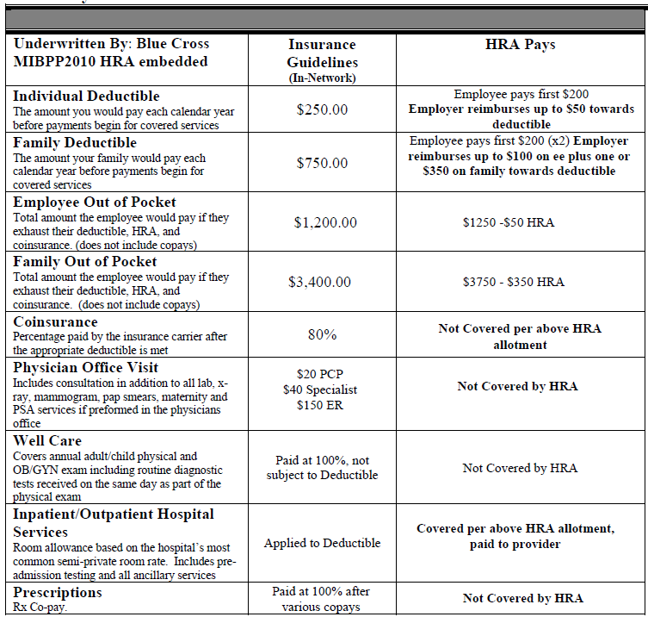
HRA Allotment Summary

Slide 12
The HRA Claim Process
3) BlueCross & BlueShield will process the claim and send the Explanation of Benefits (EOB) to Envision Healthcare to process the claim. EOBs are sent directly from BCBS to Envision, you do not need to submit the claim form.
1) Employee or covered family member visits the health care provider.
2) The health care provider submits claim for services to health insurance carrier.
5) Envision will pay the provider directly for medical expenses according to the HRA plan guidelines.
4) Envision receives claim from BlueCross & BlueShield. Envision will process the claim if it is eligible for reimbursement through the HRA.

Slide 13
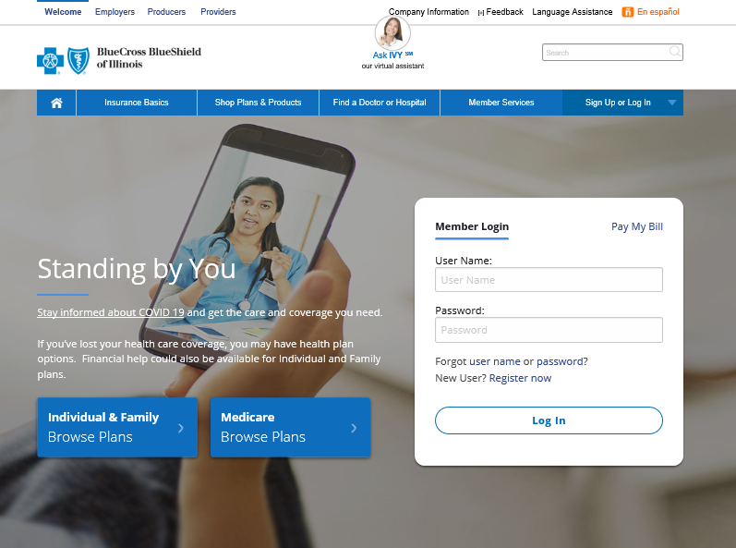
3 Easy Ways to Find a Network Provider
1
Look for the “Provider Finder” button on bcbsil.com®
Call the number on your health plan ID card
Search using the BCBSIL
mobile app
2
3

Slide 14
Choosing an HMO Primary Care Physician (PCP)
How can a PCP
help you?
PCP requirements:
Must be in the Blue Advantage Network for HMO
Must be located near your home.
Must be a general practice, family practice, pediatrician or internal medicine physician.
Can be selected for the entire family, or each covered dependent can select their own.
PCP information needed to sign up:
First name and last name.
PCP number (you will find this number online when you do a PCP search).
Medical Group/IPA name and number (you will find this number online when you do a PCP search).
They get to know your health history.
They can help prevent and catch health issues before they become serious.
They can refer you to a specialist, if needed.
Find your PCP at bcbsil.com

Slide 15
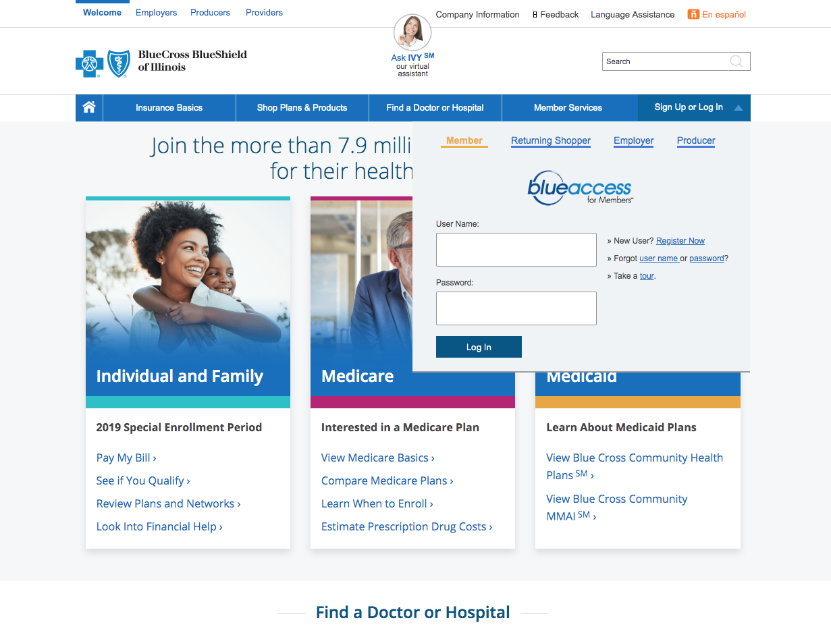
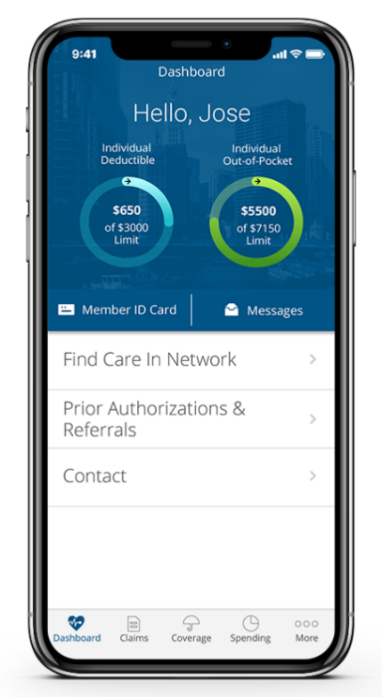
Blue Access for Members & BCBSIL App
Go to bcbsil.com and log in to Blue Access for Members via web or mobile
Click Register Now if you are a new user
To download the app, go to Google Play, the App Store or text* BCBSILAPP to 33633
To register you will need your identification number on the front of your ID card OR you can call the Customer Service number on the back of the card.

Slide 16
Well on Target Fitness Program

Slide 17
Telemedicine

Slide 18
When to Use Telemedicine
NO COPAYS! You only pay the cost for any prescribed medication(s).
Virtual Visits are appropriate for:
Allergies
Bladder infections
Bronchitis
Coughs/colds
Diarrhea
Fevers
Flu
Headaches/migraines
Pink eye
Rashes
Sinus infections
Sore throats
Stomachaches
And more
25%
of ER issues can be diagnosed and treated via Virtual Visit.

Slide 19
How Telemedicine Works
Step 1
Activate
Activate your account online or by calling member services. Once activated, you will need to setup your member profile and complete your electronic health record.
Step 2
Request a Consult
Login to your account
online at www.1800MD.com or call member services at 1.800.530.8666 to request a consult anytime 24/7.
Step 3
Receive Care
Receive diagnosis and treatment, giving you quality care and peace of mind wherever you are.

Slide 20
Dental

Slide 21
Dental PPO
 | In-Network* | Out of Network**
Your Network Is | Traditional Preferred | N/A
Deductible*—Before the plan pays, you’ll pay all costs up to: | $50 / $150 | $50 / $150
Employee / Family (Excludes Preventive and Diagnostic)
Coinsurance*—Once the deductible is met, the plan pays: | 100% | 100%
Preventative and Diagnostic Services Routine oral examinations Routine cleanings Sealants & Fluoride treatments
Basic Dental Services:
Fillings Periodontics Endodontics Stainless Steel Crowns | 80% | 80%
Major Dental Services: | 50% | 50%
Crowns and Bridges Dentures Implant Related Services
Annual limits—This is the most the plan will pay in the plan year. | $1,500 | $1,500
Child Orthodontia (through age 18) | 50% | 50%
Orthodontia Lifetime Maximum | $1,000 | $1,000
*Refer to the benefit summary for a comprehensive overview of covered services.

Slide 22
Find a Provider
Dentist Locator
Find general dentists and specialist
To find a dentist in Humana’s Dental Traditional Network log on to Humana.com or call 800.233.4013
Plan Information
View benefit summary
Access your electronic ID card
View explanation of benefits (EOB)
Claims Information
Review claim status and history
Download the Humana® app
Access your benefits and get help anytime, anywhere with the Humana smartphone app.

Slide 23
Life and Accidental Death &
Dismemberment (AD&D) Plans

Slide 24
Basic Life and AD&D
Employer Paid
Benefit amount is $50,000.
Age Reduction Schedule: 50% of the original amount at age 70. Benefits terminate at retirement.
AD&D (Accidental Death & Dismemberment) pays in addition to Life insurance.
Conversion (Life only): Included
Additional Resources:
Beneficiary Resource Service – includes grief, legal, and financial counseling and much more for beneficiaries.
Travel Resource Services – provides emergency medical assistance, financial and legal assistance while traveling.
Notes:
Portability means that you take with you—or “port”—your group coverage after employment ends. Porting is a good solution for employees who are 69 years old or younger and are not terminating employment due to retirement, illness, or injury. Ported coverage is term life insurance to age 70, and the employee pays premium for coverage directly to BCBS.
Conversion means you change—or “convert”— your group coverage to an individual policy without having to answer any medical questions. Conversion may be a good solution for employees who are leaving a job, reducing hours, retiring, or have reached an age when group coverage may be reduced or eliminated.
Converted coverage is permanent universal life insurance.

Slide 25
NEW Benefit!!
Voluntary Life and AD&D
Employee Paid
 |  | Employee Must Be Enrolled
 | Employee | Spouse | Child
Benefit Amounts | $10,000 - $500,000 | $5,000 - $100,000 | $5,000 - $10,000
Benefit Increments | $10,000 | $5,000 (not to exceed 50% of employee amount) | $5,000
Guarantee Issue* | $150,000 | $25,000 | N/A
Age Reduction | Life and AD&D benefits reduce by 35% of the original amount at age 65 and further reduce by 50% of the original amount at age 70.
Conversion Portability (Life coverage) | Included Employee only | Included N/A | Included N/A
Cost | Varies depending on age and/or amount; refer to HR for pricing
*A One-Time Open Enrollment is being offered: During this one-time special Enrollment period, Employees, Dependent Spouses and Dependent Children may enroll for coverage, apply for additional coverage or request changes to existing coverage up to the Guarantee Issue Benefit Limit listed above.

Slide 26
How much will it cost me?
Employee Paid

Slide 27
Vision Plan

Slide 28
Network Vision Benefits
Service/Product: | Benefit Frequency | Network Copay/Allowance
Comprehensive eye exam | Every 12 months | $10 copay
Frames | Every 24 months | $120 allowance
Eyeglass lenses Choice of single-vision or lined bi-focal, tri-focal or lenticular lenses | Every 12 months | $25 copay
Contact lenses Lens fitting | Every 12 months | $40 copay
Elective contact lenses Contact lenses outside the covered selection | TBD | TBD
or
Refer to the benefit summary for a comprehensive list of covered services.

Slide 29
Enjoy More Extras:
Member-Only Savings & Discounts
20% off
additional pair of glasses
15% off
standard LASIK prices
or 5% off the promotional
price
20% off
any remaining balance
over the frame allowance
75% coverage
for approved low vision aids,
up to $1,000 every 2 years
20% off
any non-covered items,
including non-prescription
sunglasses
up to 60% off
on the latest brand-name
hearing aids

Slide 30
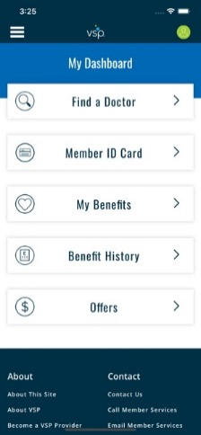
Go Digital and Get the Most
Out of Your Benefits
Access vsp.com® for:
Benefits and eligibility
Download ID cards and EOBs
Provider directory
Check claim status
Online offers and services
Download the VSP® app
Access your benefits and get help anytime, anywhere with the VSP smartphone app.

Slide 31
2022 Open Enrollment
Open Enrollment begins May 1, 2022 – May 16, 2022
If you want to make any changes to your current elections, you are required to complete the appropriate carrier enrollment application.
If you are not making any changes to your current elections no action is required. Existing plan elections will automatically transfer over to the new plan year.
All changes become effective July 1, 2022.
If you have any questions, please contact Kimberly Lewis.

Slide 32
QUESTIONS?
Knowing your benefits helps you
make more informed choices.

